Slide 1
Name: Swapnil Ghosh
Group: A2
Roll: 001911001067
TASK 21

Slide 2
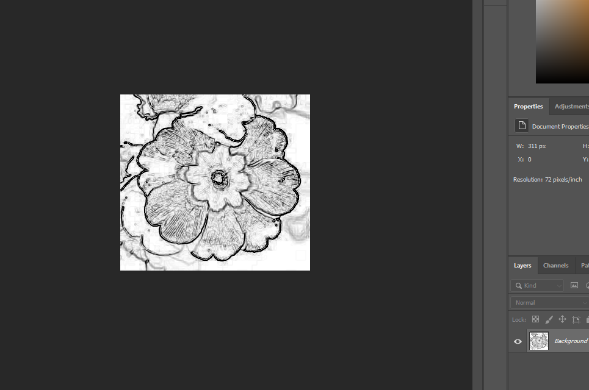
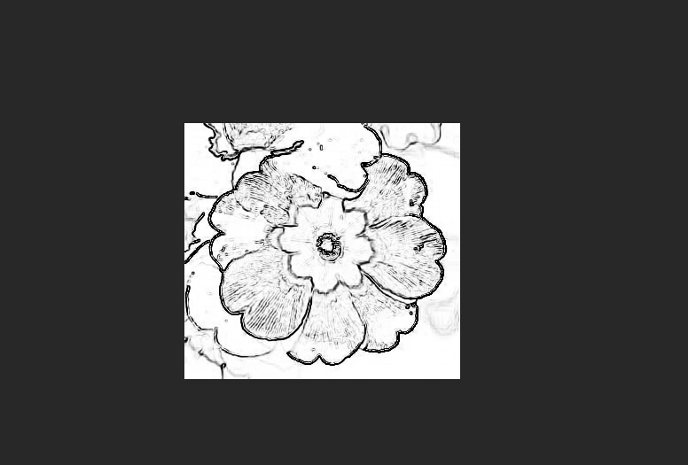
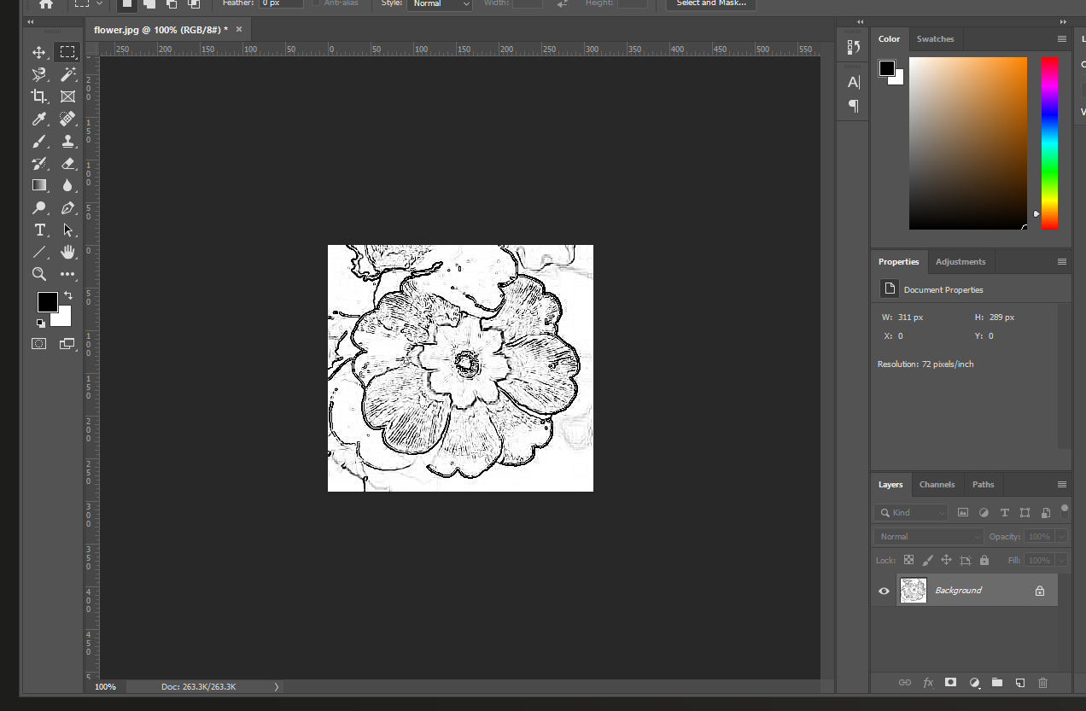
Step-1) Open file FLOWER.JPG in Photoshop.
Step-2) Converted to grayscale by choosing Image > Adjust > Desaturate.
Step-3) Choose the Filter > Stylize > Find edges.
Step- 4) Choose Image > Adjust > Brightness Contrast with settings B: 19, C: 87.
Step-5) Choose the Filter > Sharpen > Sharpen more.

Slide 3
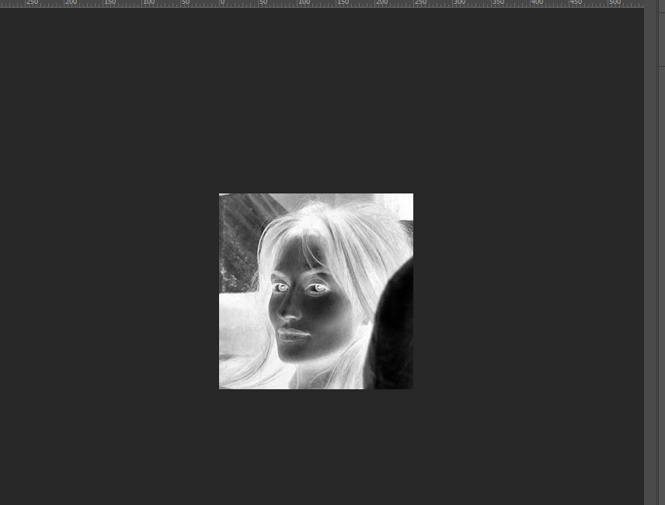
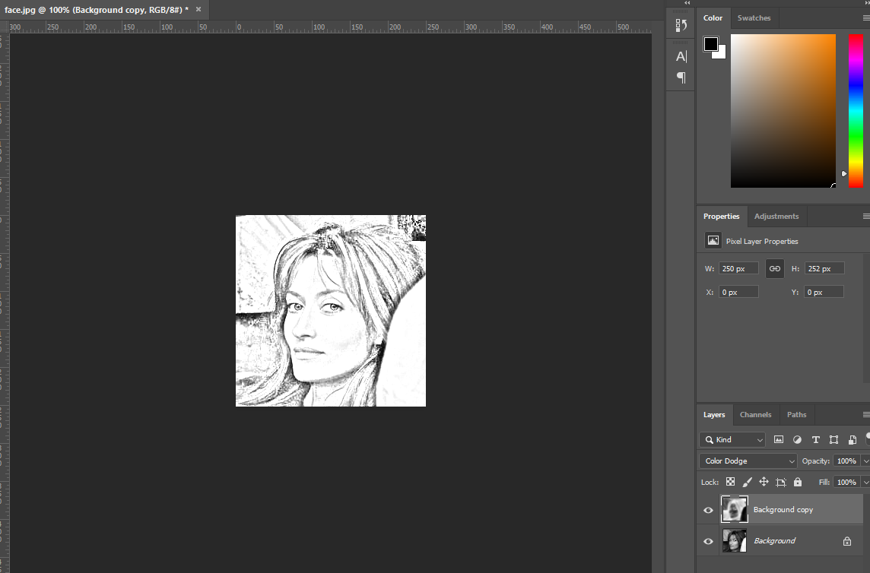
Step- 1) Opened the file FACE.JPG.
Step- 2) Converted to grayscale by choosing Image > Adjust > Desaturate.
Step- 3) Duplicated the Background layer.
Step- 4) Choose Image > Adjust > Invert to invert the duplicate layer
Step- 5) Changed the layer mode to Color Dodge
Step- 6) Choose Filter > Blur > Gaussian Blur, radius 5.

